Slide 1




Netflix Movies Data
Analysis in SQL
Netflix Title 2021 Dataset
BY
Hrushikesh Shinde
13-10-2024

Slide 2
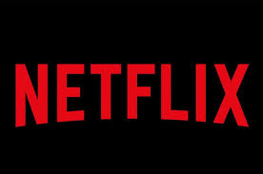
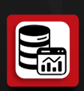


Introduction
This dataset contains information about Netflix titles, including movies
and TV shows, with details like release year, duration, country, director, rating,
and more.
Objective
The objective of Netflix movies data analysis is to gain insights into viewing patterns, genre preferences,
and movie performance, as well as to identify trends and correlations that can inform content strategy,
improve user recommendations, and enhance overall viewer engagement.

Slide 3
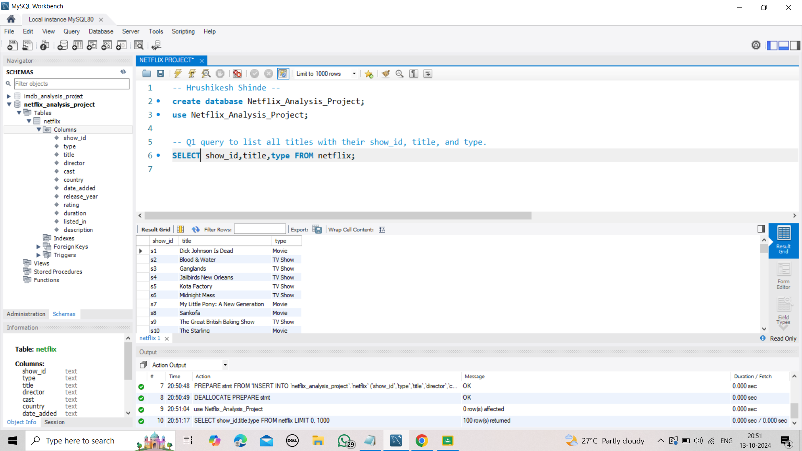

Slide 4
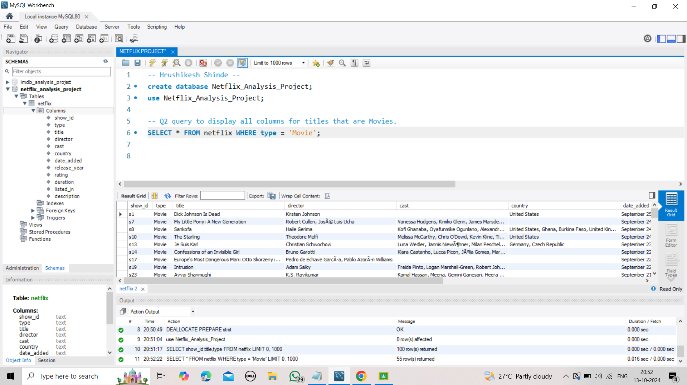

Slide 5
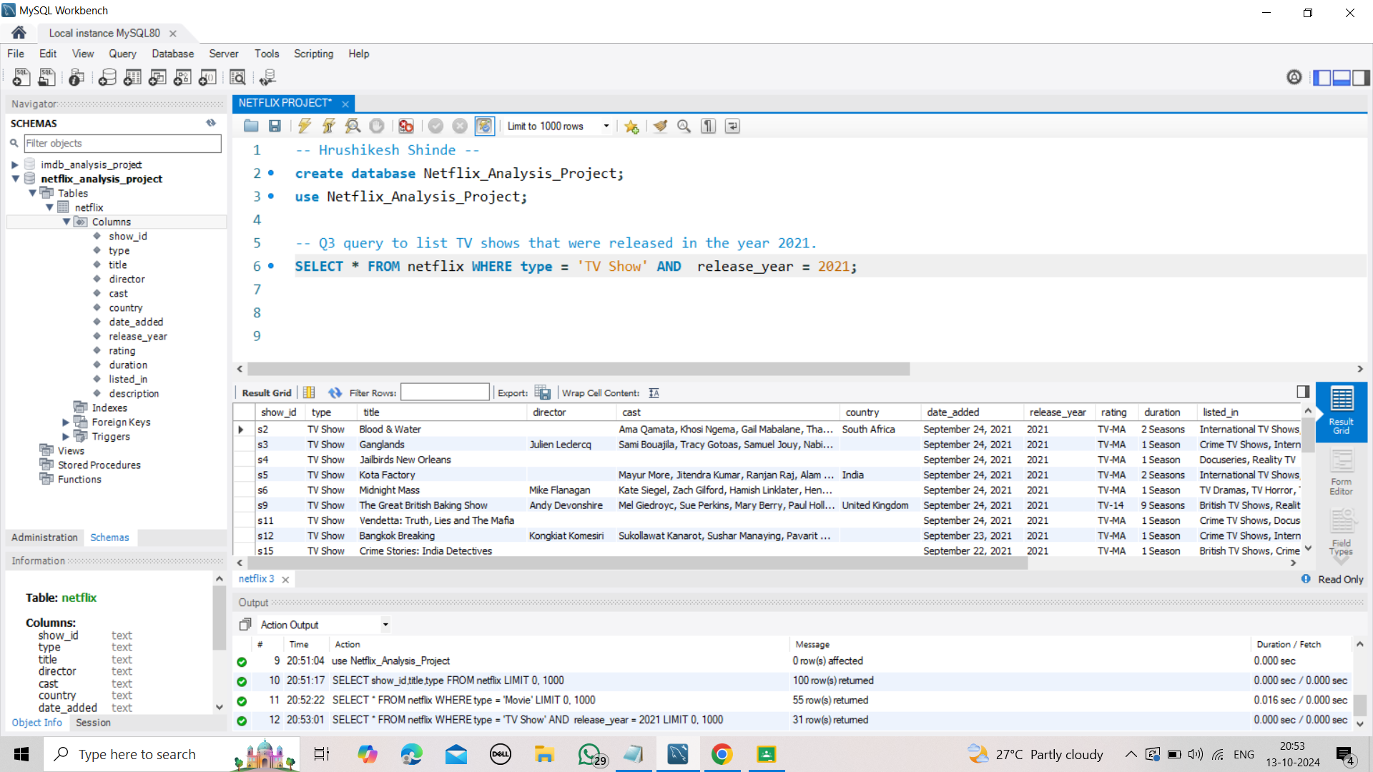

Slide 6
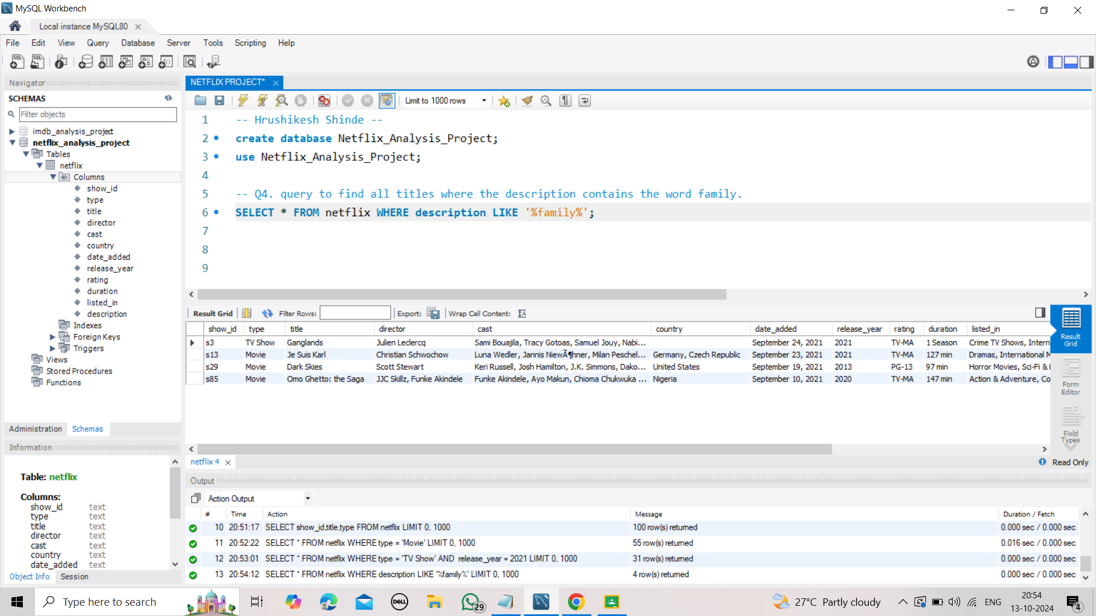

Slide 7
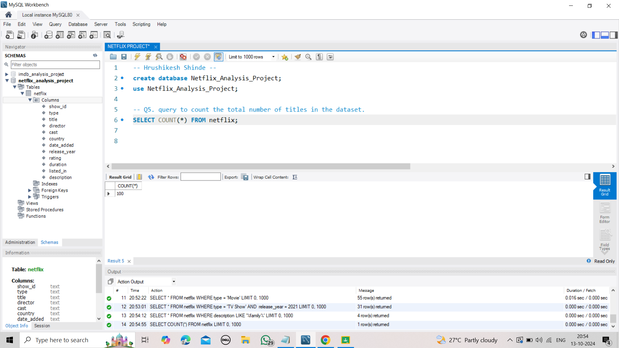

Slide 8
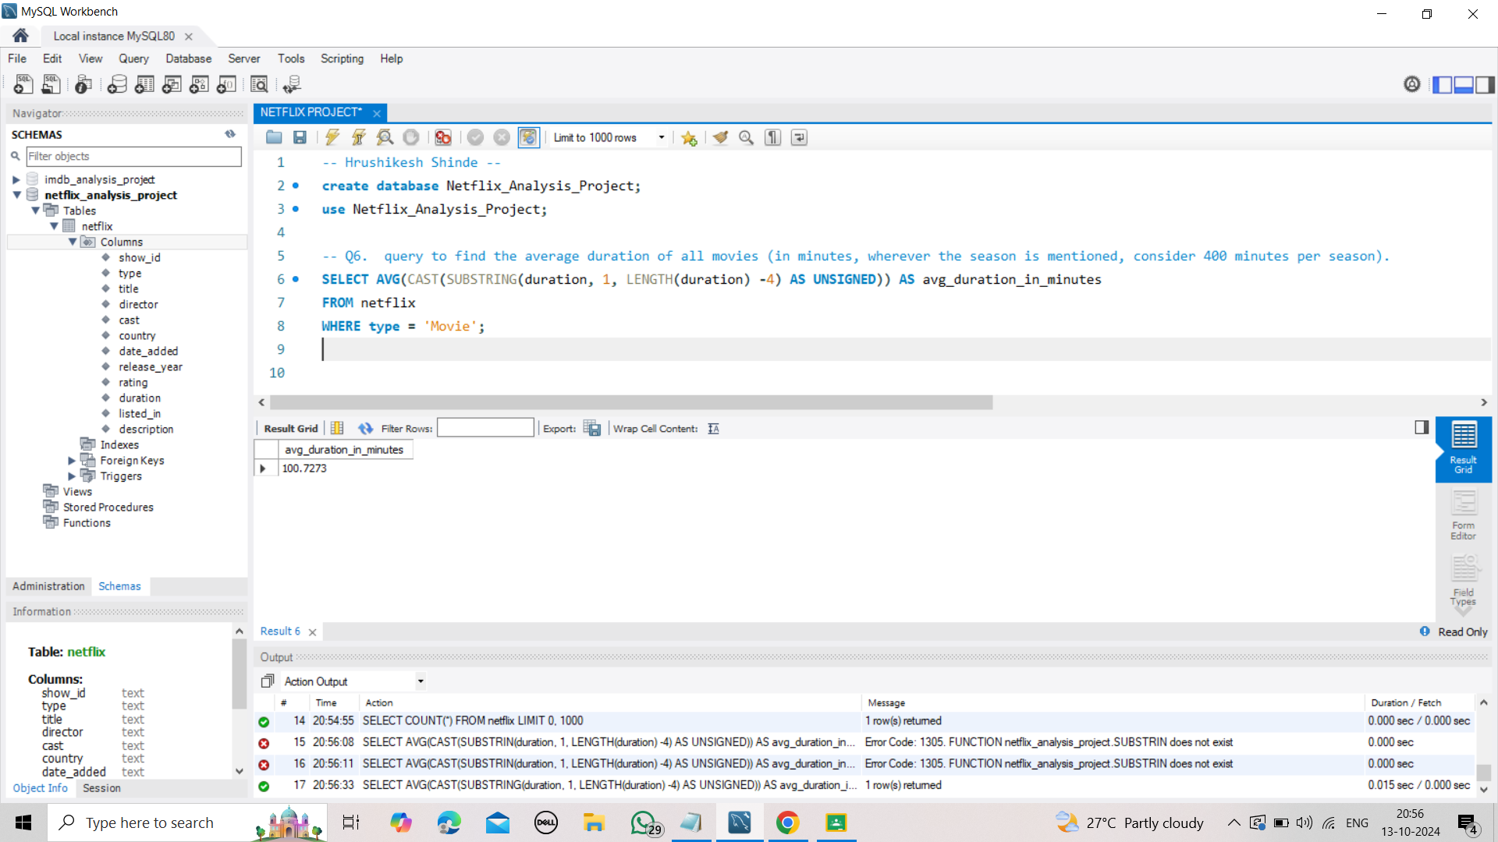

Slide 9
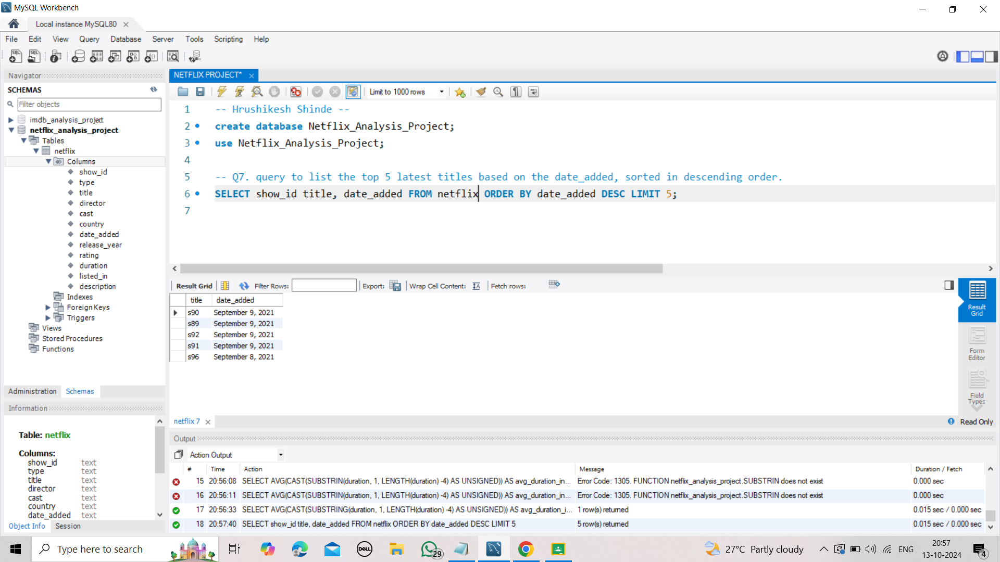

Slide 10
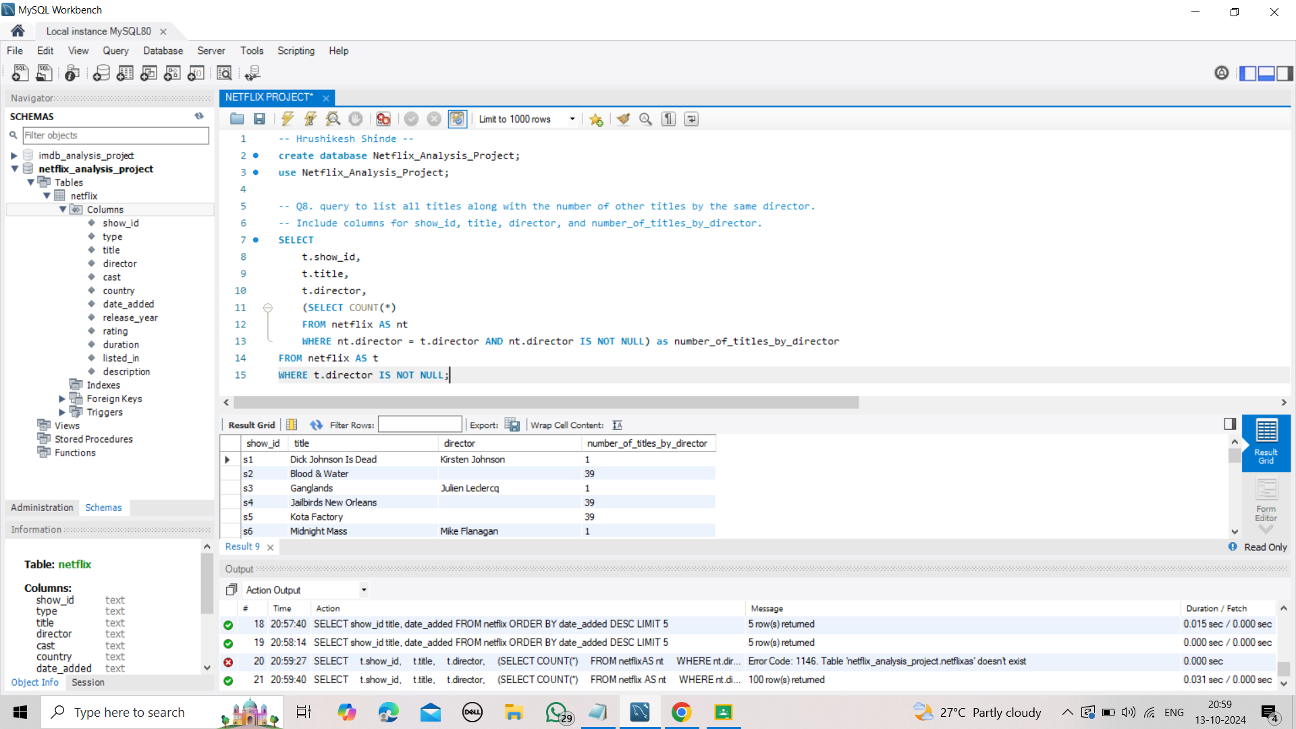

Slide 11
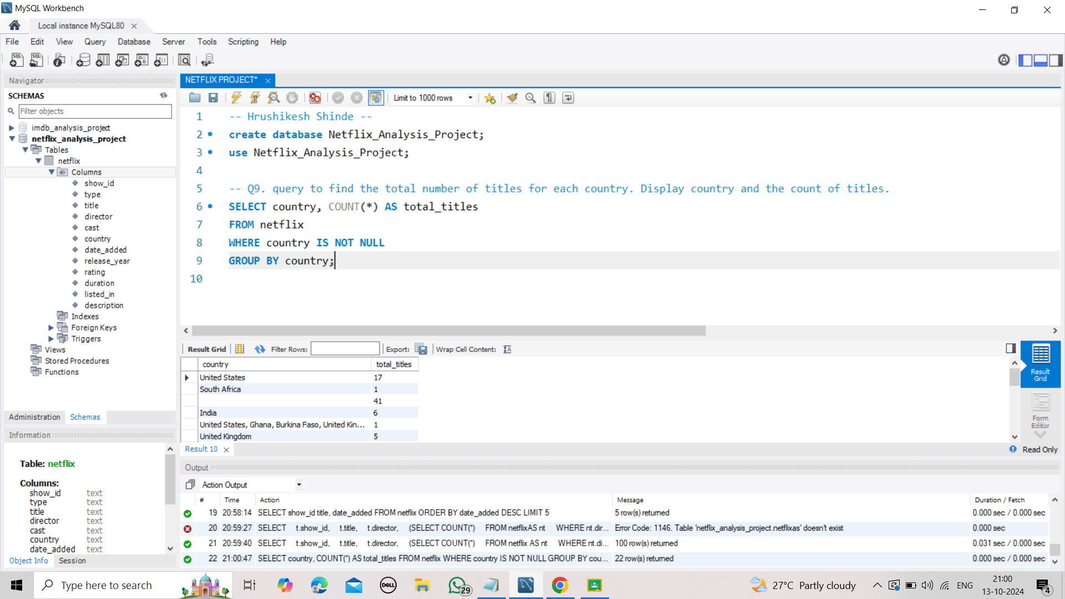

Slide 12
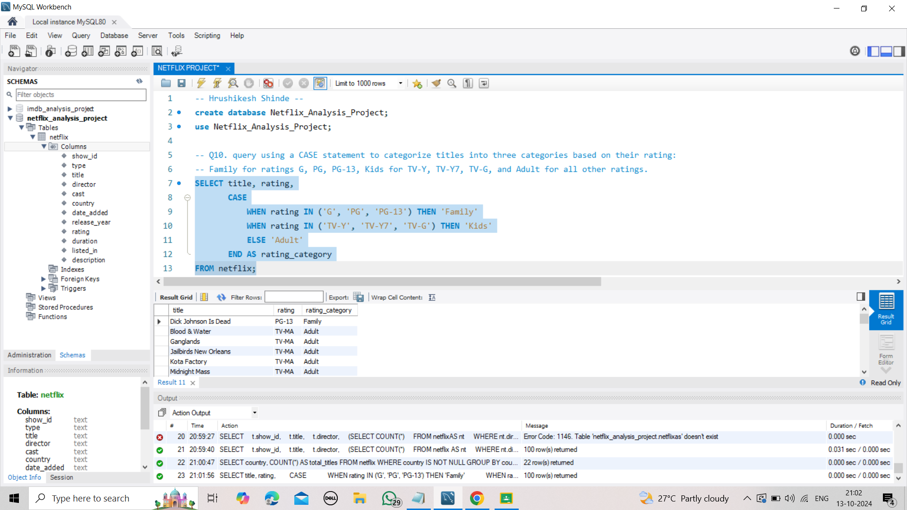

Slide 13
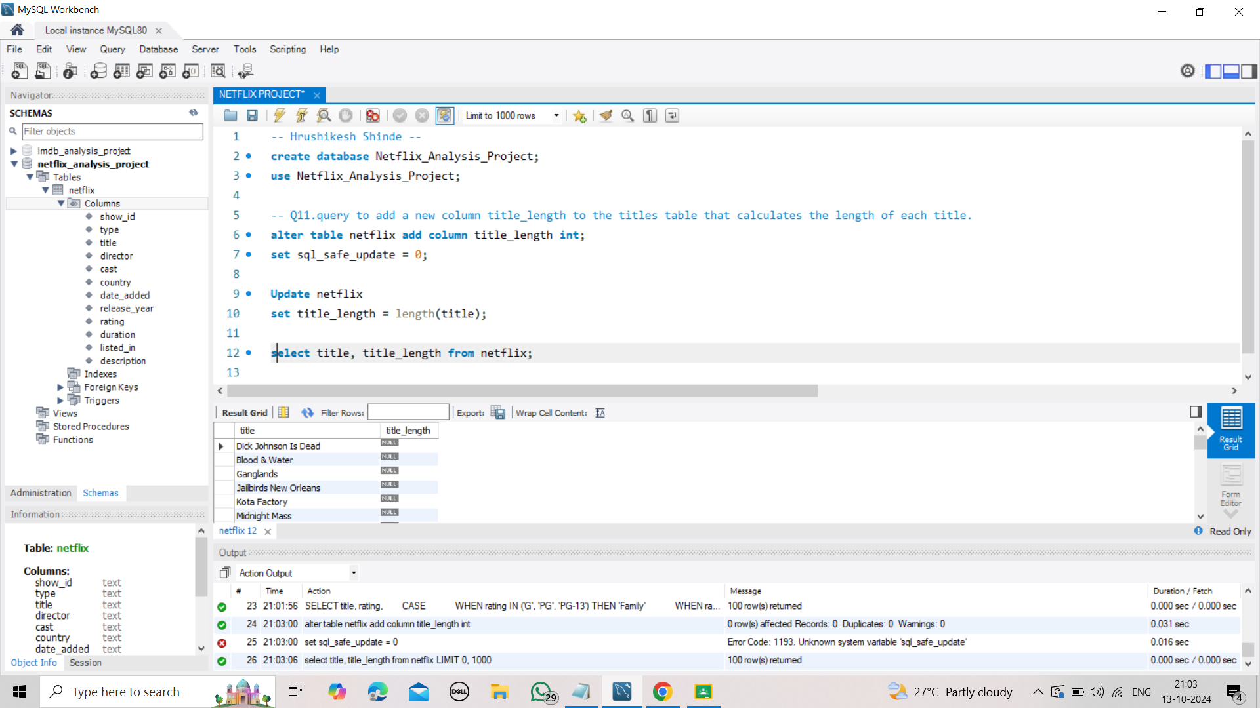

Slide 14
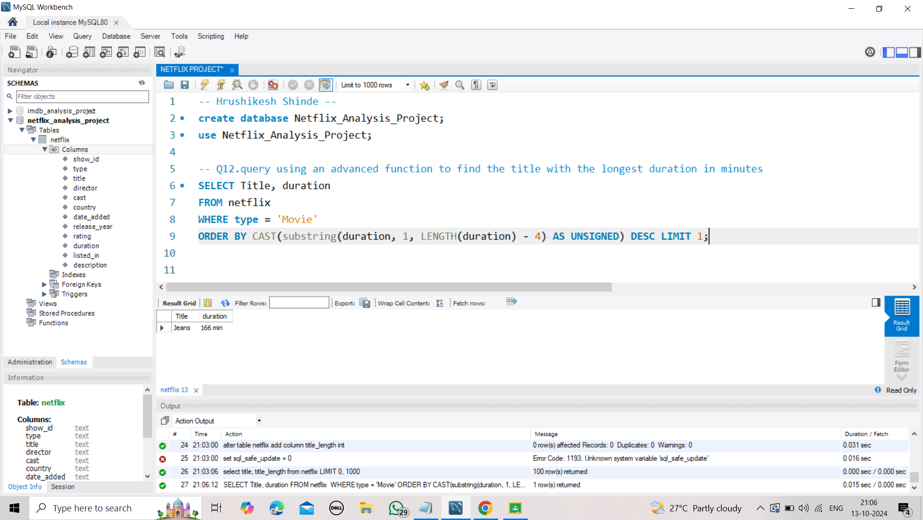

Slide 15
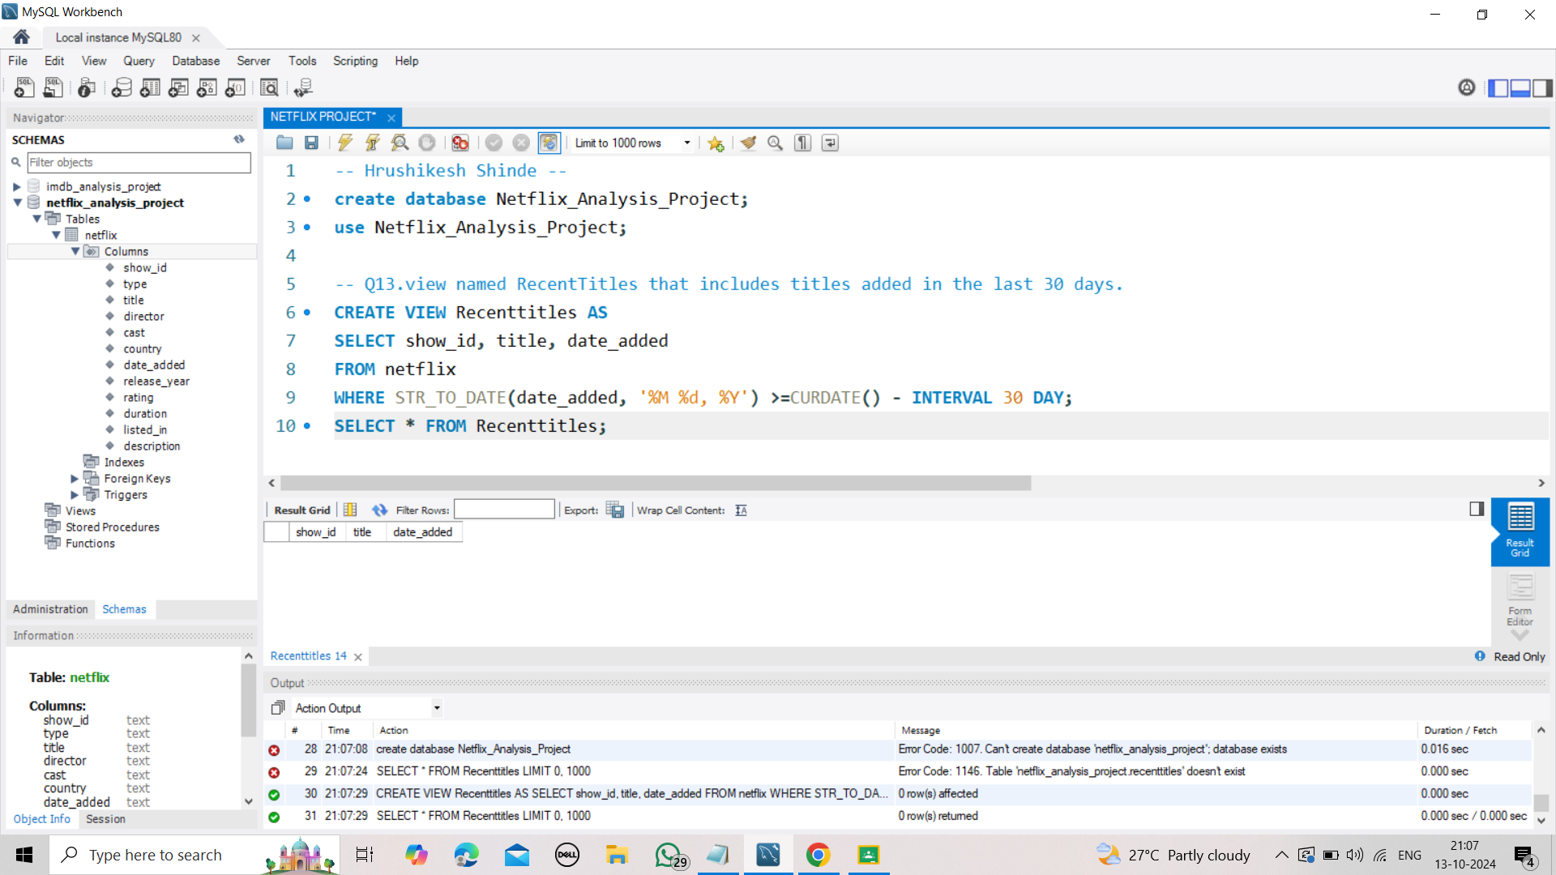

Slide 17
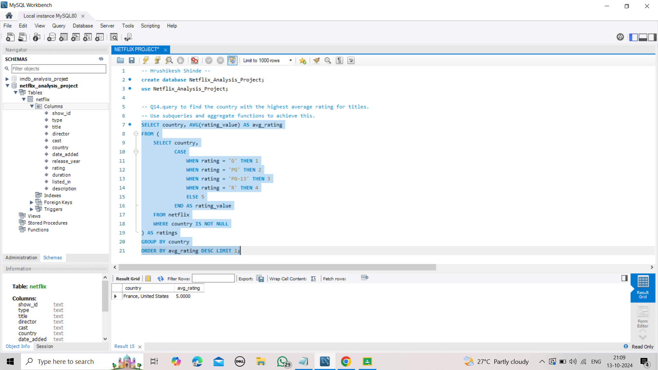

Slide 18
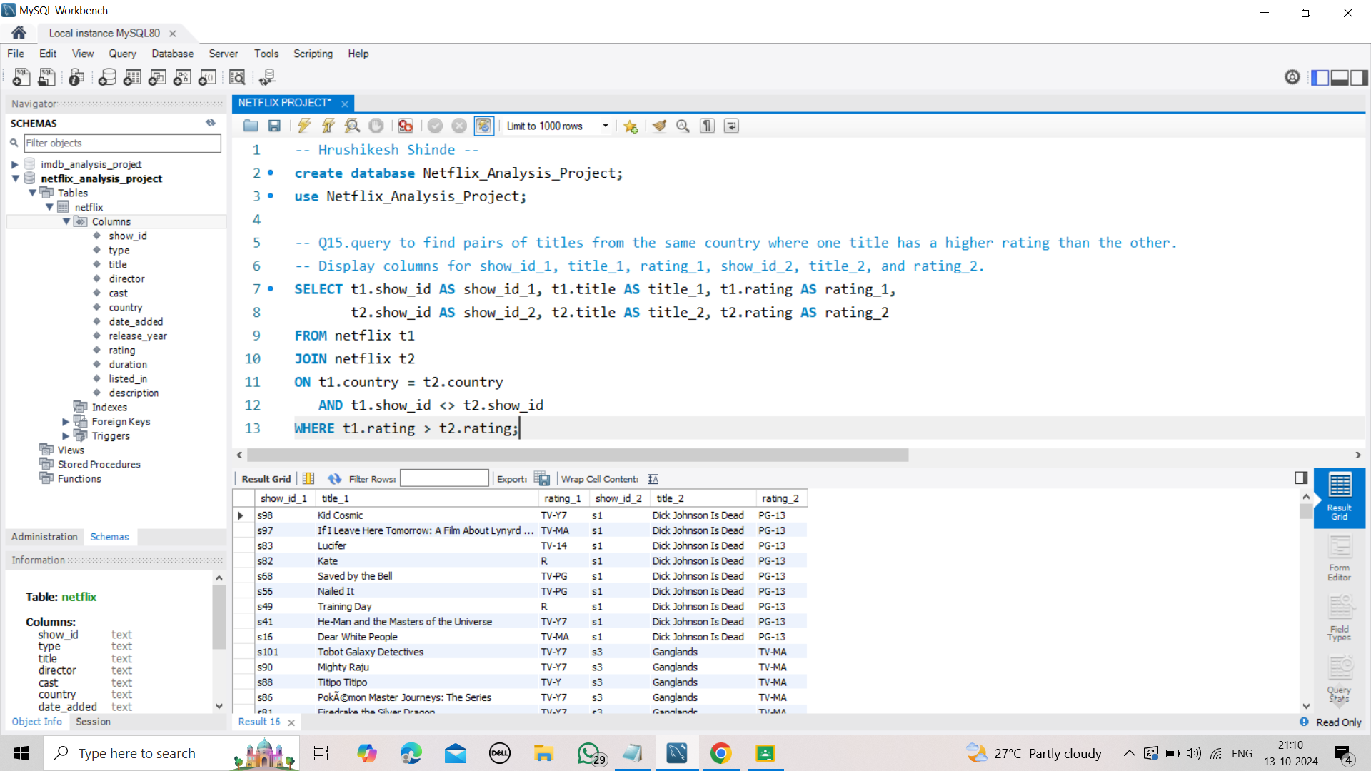

Slide 19



Conclusion
The Netflix movies data analysis highlights valuable insights into user preferences, viewing habits, and content trends. Key findings reveal that specific genres, such as drama, action, and comedy, tend to perform better, while factors like high IMDb ratings and notable actors significantly influence viewership. Additionally, seasonal trends affect viewing behavior, with spikes in activity during holidays and weekends. These insights suggest that Netflix can optimize its content strategy by focusing on popular genres, improving recommendations, and strategically releasing content to match peak viewing times, ultimately enhancing user engagement and satisfaction.

Slide 20


